Slide 1


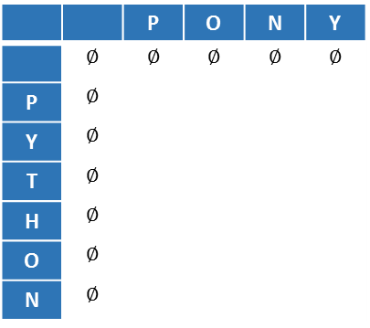
מציאת מחרוזת LCS
First: P O N Y
Second: P Y T H O N
Y | N | O | P
 |  |  |  | P
 |  |  |  | Y
 |  |  |  | T
 |  |  |  | H
 |  |  |  | O
 |  |  |  | N
Y | N | O | P
$$∅$$ | $$∅$$ | $$∅$$ | $$∅$$ | $$∅$$
 |  |  |  | $$∅$$ | P
 |  |  |  | $$∅$$ | Y
 |  |  |  | $$∅$$ | T
 |  |  |  | $$∅$$ | H
 |  |  |  | $$∅$$ | O
 |  |  |  | $$∅$$ | N
↖
←
←
←
↑
↖
↖
↖
1
1
1
1
↑
↖
↖
↖
1
1
1
2
↖
↖
↖
1
1
1
2
↑
↑
↖
←
↖
1
1
1
2
1
2
2
2
↑
↑
↖
←
2
1
3
3
p
o
n

Slide 2
HIRSHBERG
First: P O N Y
Second: P Y T H O N
 | Y | N | O | P
 | -8 | -6 | -4 | -2 | 0
 | -4 | -2 | 0 | 2 | -2 | P
 | 0 | -1 | 1 | 0 | -4 | Y
 | -2 | 0 | -1 | -2 | -6 | T
-6 | -5 | -4 | 0 | 1 |  | H
-4 | -3 | -2 | 2 | 0 |  | O
-2 | -1 | 0 | -2 | -4 |  | N
0 | -2 | -4 | -6 | -8
 |  |  | P
 |  |  |  | P
 |  |  |  | Y
Y | N | O |  | T
 |  |  | H
 |  |  | O
 |  |  | N
-2 | 0 | -1 | -2
-5 | -4 | 0 | 1
-7 | -4 | -1 | -1

Slide 3
HIRSHBERG
First: P O N Y
Second: P Y T H O N
 |  |  |  | P
 |  |  |  | 2- | 0
 |  |  |  |  | 2- | P
 |  |  |  |  | 4- | Y
 | Y | N | O |  | 6- | T
6- | ↘ | ↘ |  | H
4- | ↘ | ↘ |  | O
2- | ↘ |  | → | N
0 | 2- | 4- | 6-
 |  |  | P
 |  |  | 2 | P
 |  |  | 0 | Y
Y | N | O | -2 | T
-5 | -4 | 0 | H
-3 | -2 | 2 | O
-1 | 0 | -2 | N
↖
↑
↑
↓
↘
↘
P
O
N

